Slide 1
How asymmetries in the feedforward signals are exploited by target neurons to elaborate feature selectivity
Yamni Mohan
Supervisors: Prof. TR Vidyasagar; Dr. Ekaterina Levichkina
(also- Dr. Sivaram Viswanathan and Dr. Jaikishan Jayakumar)

Slide 2
Introduction

Slide 3
Part 1: Sub-cortical Orientation Biases
Two parts
Orientation Tuning in the Superior Colliculus
Orientation Biases in the inputs to the cortex

Slide 4
Orientation Tuning of the Superior Colliculus neurons
Introduction

Slide 5
Orientation Tuning of the Superior Colliculus neurons
Methods

Slide 6
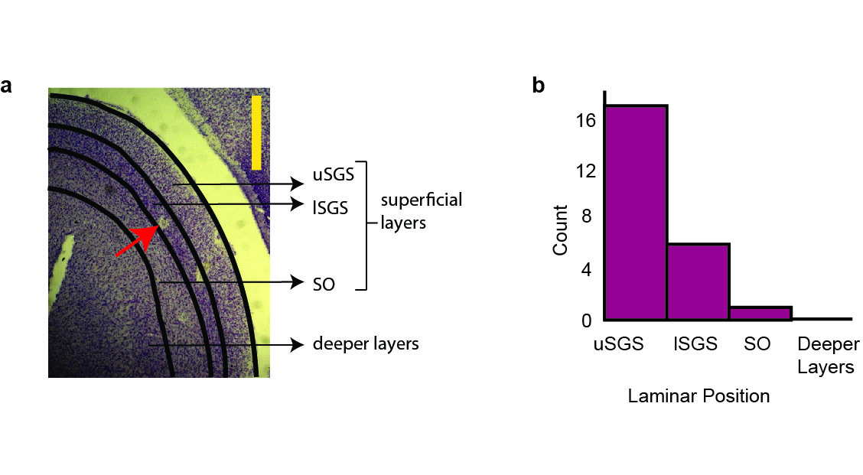
Most neurons were from the superficial (visual) layers

Slide 7
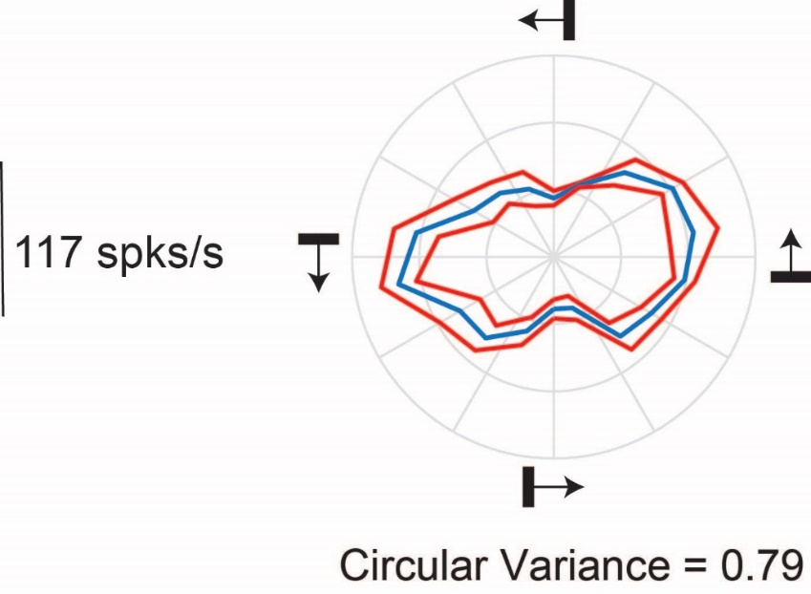
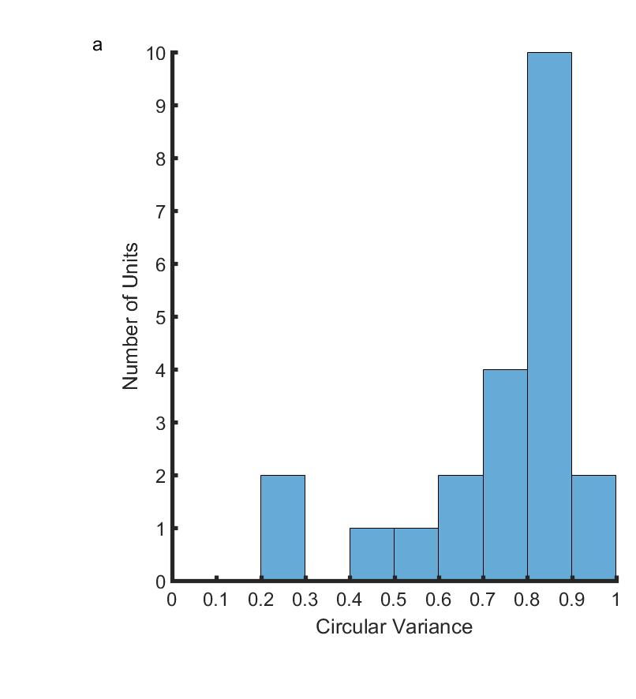
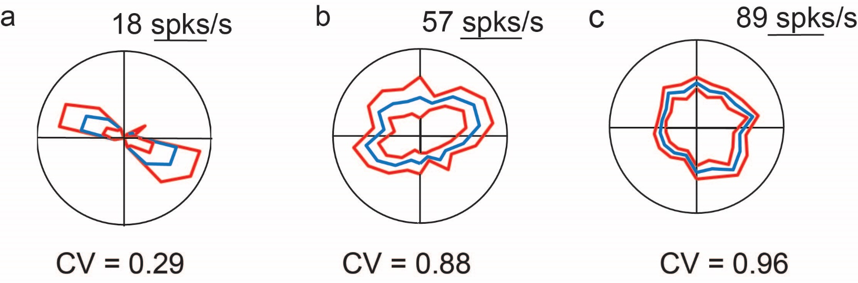
These neurons were orientation tuned in response to bars

Slide 8
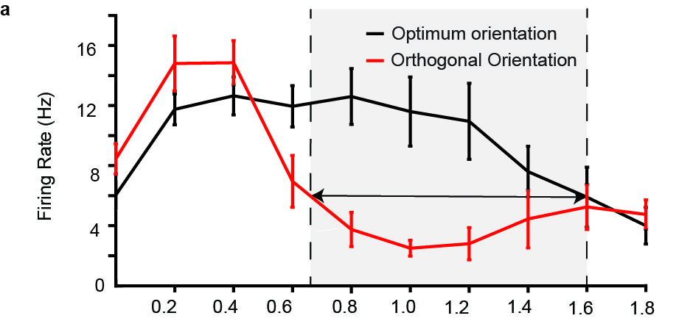
This orientation tuning was related to the spatial frequency of the stimulus

Slide 9
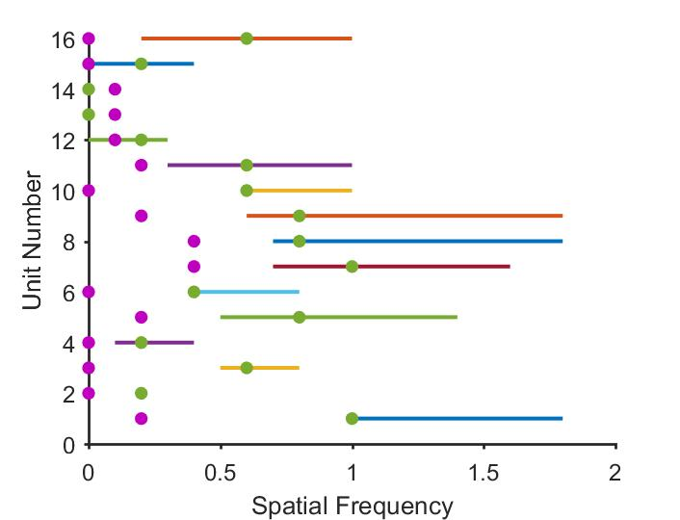
Orientation Selectivity is more prominent at higher spatial frequencies where the cortical neurons typically respond.

Slide 10
Discussion

Slide 11
Summary
Neurons in the SC are similar to the neurons in the retina and the LGN in CATS---
What does that really mean?

Slide 12
Orientation biases in the inputs to the cortex
Looked at the orientation tuning in the V1 of the primary visual cortex.
Inputs?
Used optical imaging of intrinsic signals

Slide 13
Inputs?
Rationale for the unfiltered signal compared to the filtered signal.

Slide 14
Method
OI- What do we do?

Slide 15
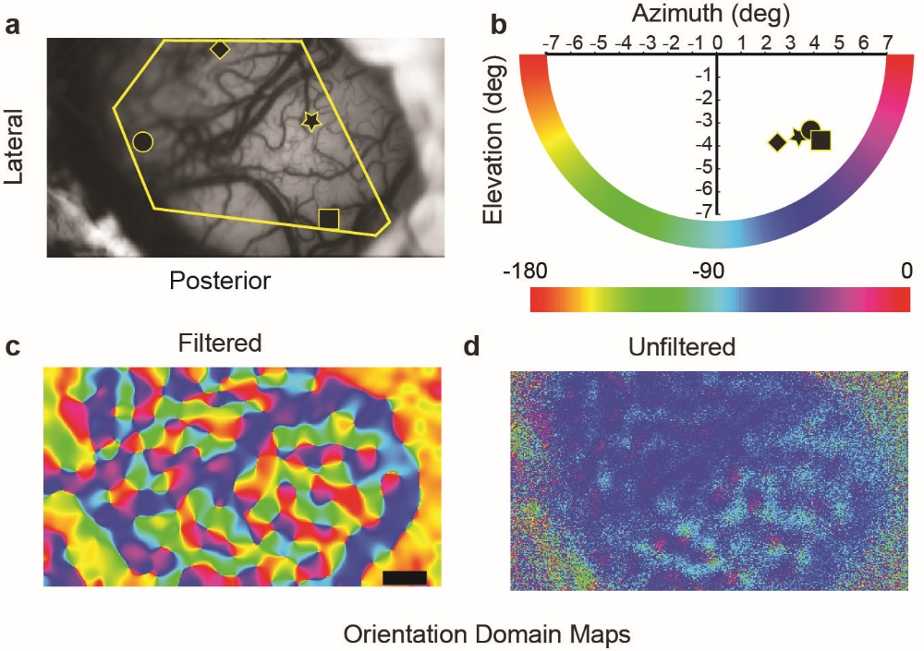
Unfiltered signal is mostly tuned to the radial orientation.

Slide 16
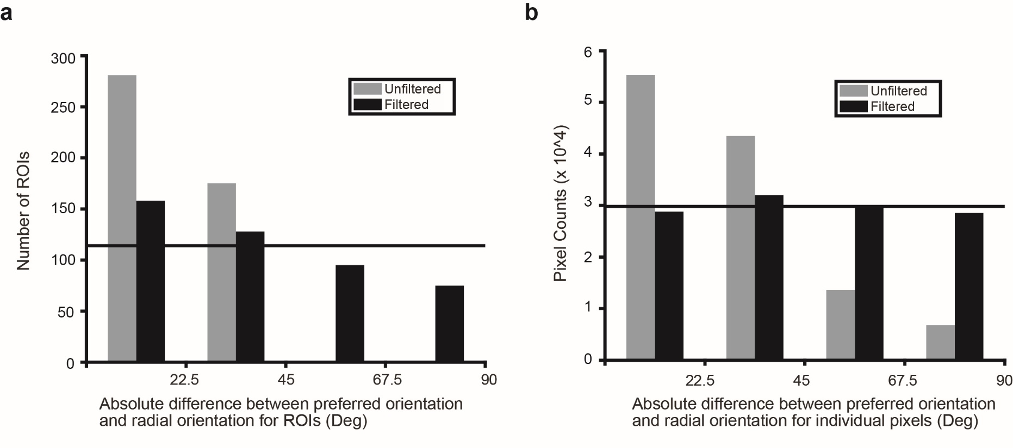
This tuning is on a fairly fine spatial scale

Slide 17
Also present on a single pixel level
ROI
Single Pixel

Slide 18
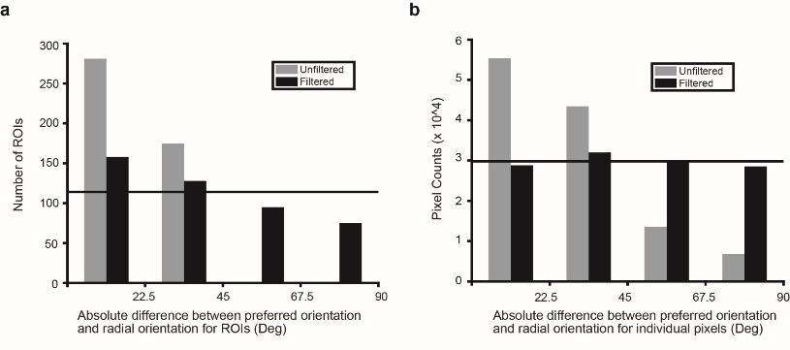
We also looked at array data
LFP data ~ Unfiltered
MUA data ~ Filtered

Slide 19
Discussion

Slide 20
Conclusion
Inputs are tuned to radial orientation- So what?

Slide 21
Part Two: Tree Shrew Primary Visual Cortex
Why study it?
What has been done so far?

Slide 22
Orientation Tuning
Organisation
Mechanism

Slide 23
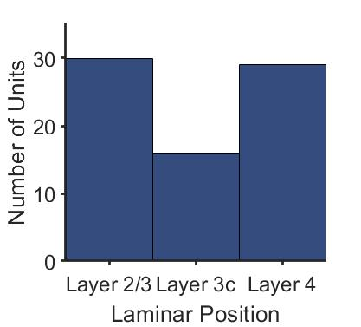
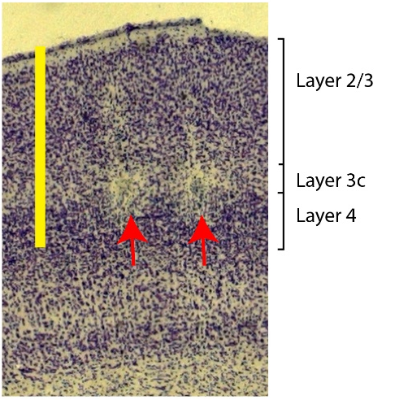
The cortical layers

Slide 24
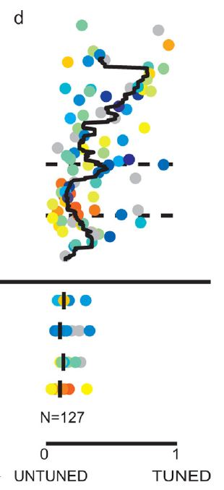
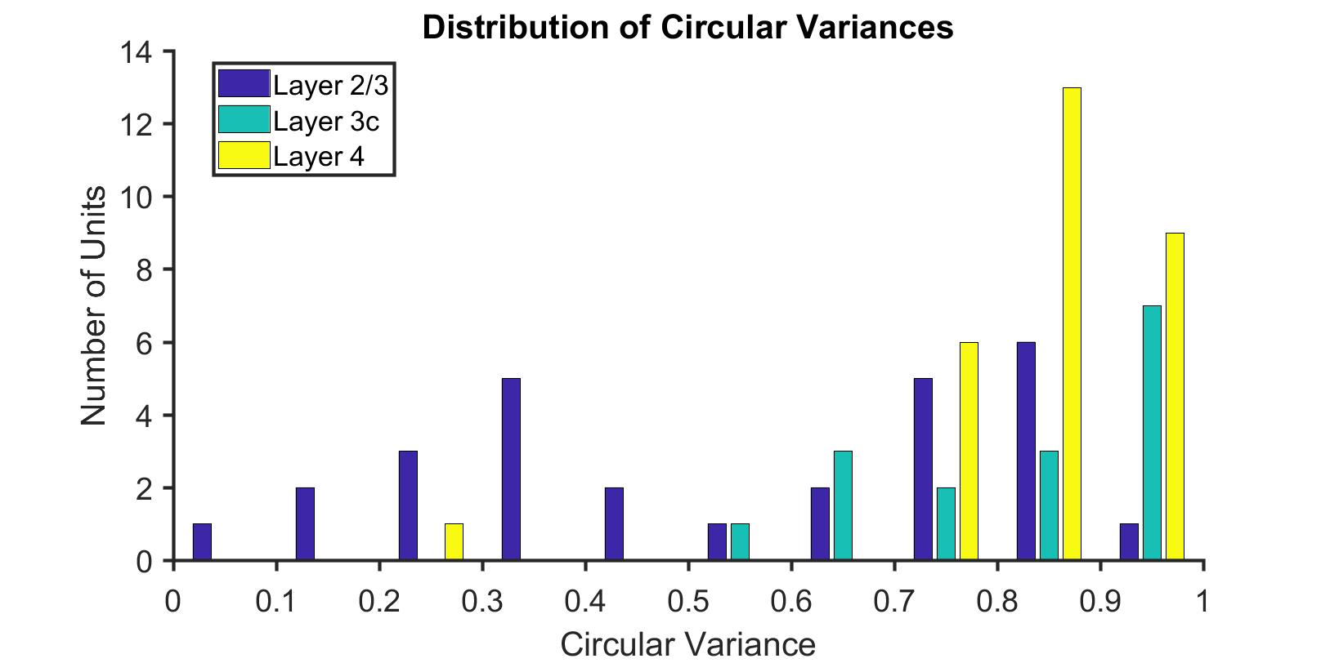
Distribution of Orientation Tuning in V1

Slide 25
Track Orientation
So far… layer 4 was thought to be unoriented.
Does the orientation remain same down the layers?

Slide 26
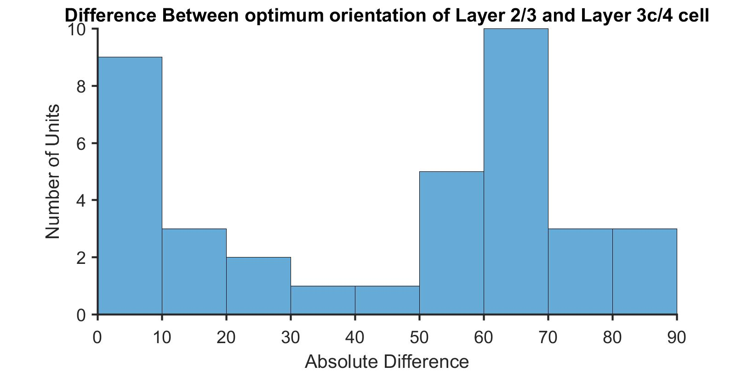
Orientation selectivity within a column
Difference in orientation selectivity between layer 2/3 cell and the layer 3c/4 cell within a track
N=37 pairs

Slide 27
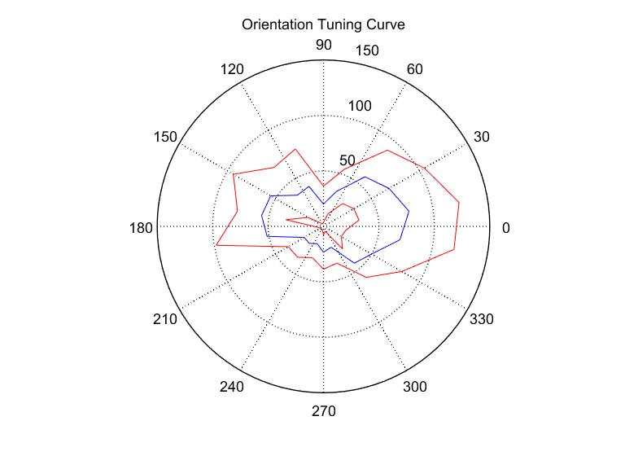
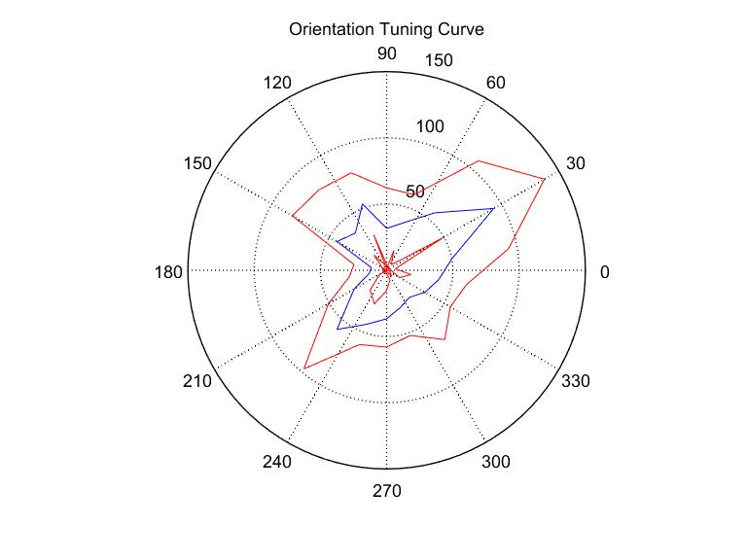
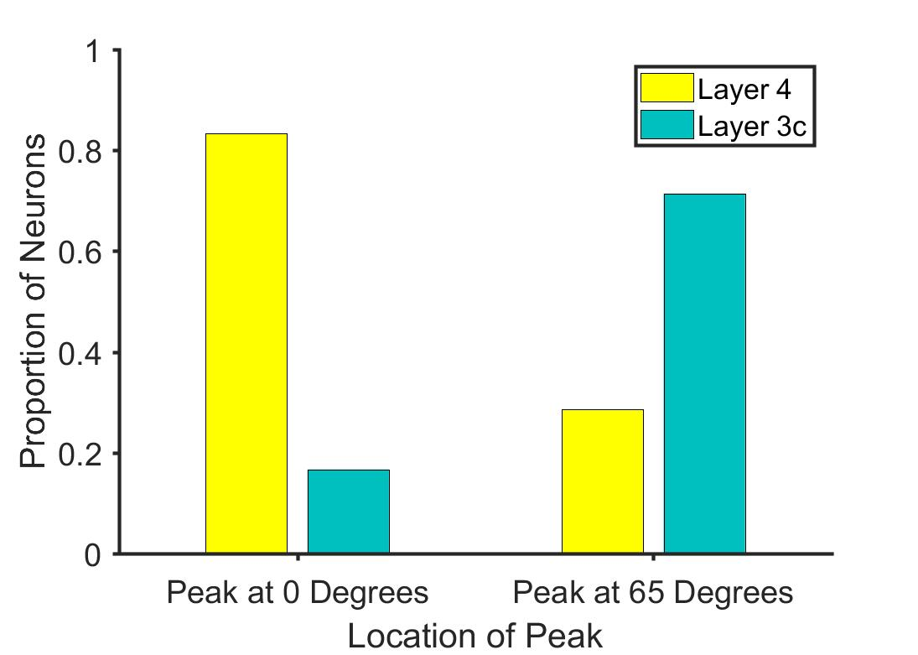
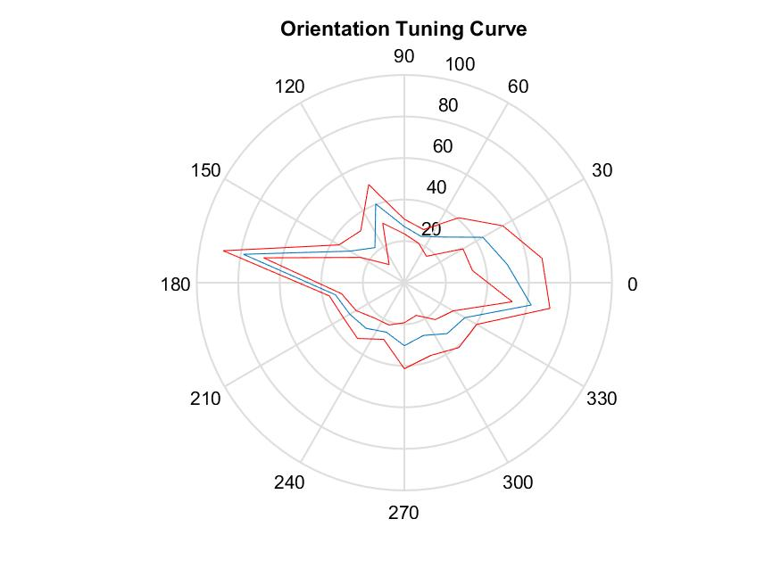
Layer 2/3
Cm= -5.7º
Layer 3c
Cm= 60.36º
Layer 4
Cm= 174.75º
P=0.016, Binomial Distribution
N=12
P=0.026, Binomial Distribution
N=21

Slide 28
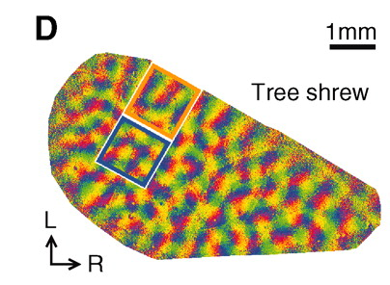
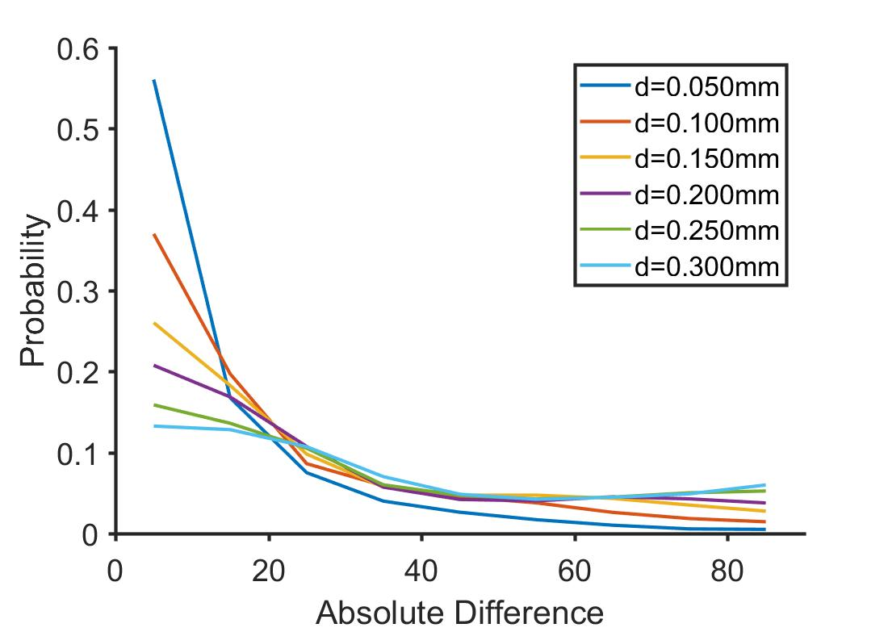
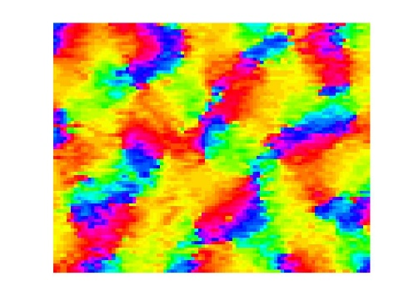
Orientation selectivity within a column- Is it chance?
Probability of getting a peak at 65º
Highest at d=0.25; p=0.045
Lowest at d=0.05; p=0.01

Slide 29
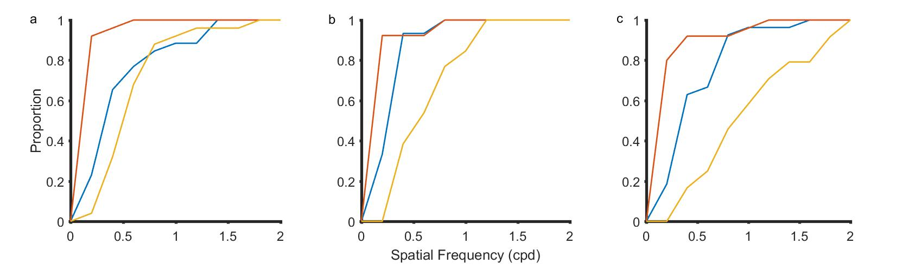
Spatial Frequency Tuning
Organisation
It’s role in orientation tuning
Layer 4
Layer 3c
Layer 2/3

Slide 30
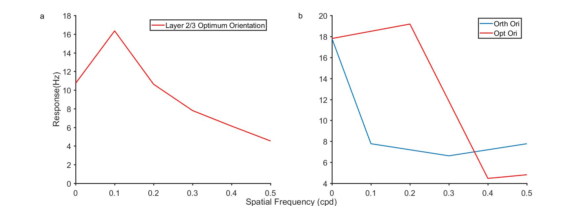
Spatial Frequency Tuning and orientation tuning (Layer 2/3 and input layer cells)

Slide 31
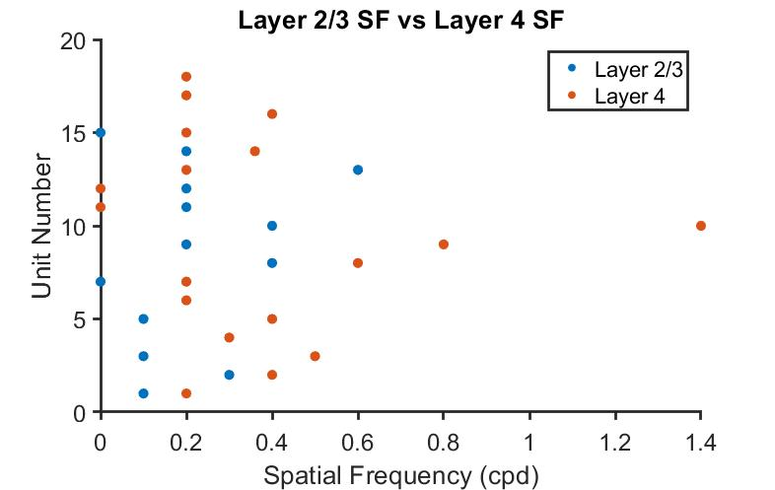
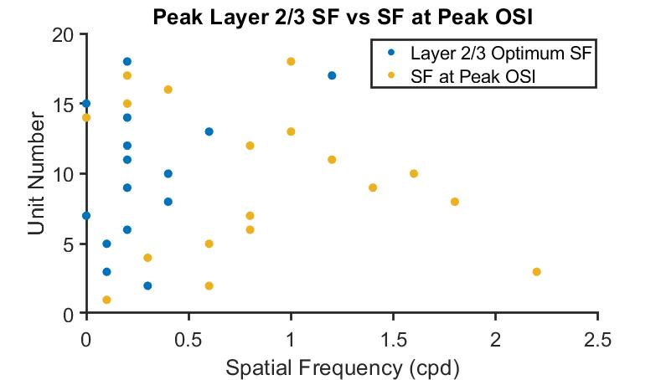
Doesn’t have the same effect as in cats and macaques

Slide 32
Are tree shrew V1 neurons ideal Fourier Analysers?
Neurons decompose the visual scene into its components-Two different components.
Edge Detectors (Space)
Detect changes in contrast- (Reference?)
Built in edge detectors- Simple cells- They have antagonistic receptive field sub-regions that are selective to very specific stimuli- bars that are the size of their individual sub- regions.
Fourier Analysers (Spatial Frequency)
An alternate model- suggests that the visual scene is first decomposed into it’s composite spatial frequencies- Transported to the visual cortex in parallel spatial frequency channels (Campbell & Robson, 1968).
Require a linear system- Simple cells – show linear spatial summation over their receptive fields.
In cats and macaques, there is a lot of evidence for simple cells being edge detectors as well as fourier analysers. It has been theorised that the truth is somewhere in the middle (Marcelja, 1980) with experiments showing the same as well (Kulikowski and Bishop, 1981; Kulikowski and Vidyasagar, 1984; 1986).
Notes:
Make an example simple cell, example bars and edges.
Spatial Frequency- natural scene.

Slide 33
Patch by Patch Fourier Analysis.
Campbell and Robson 1968: Simple cells in the primary visual cortex perform Fourier analysis on patches of the visual scene.
Robson 1975: Suggested that they do this by keeping the receptive field size constant. Studies have shown that each point in visual space have neurons tuned to a wide range of spatial frequencies.
Implication: If receptive field size remains constant in a patch of visual field, then in order for there to be a full range of spatial frequencies, the number of receptive field sub-regions should change. This also means that the bandwidth of SF tuning decreases as a function of peak spatial frequencies (at higher SFs, neurons show sharper spatial frequencies).

Slide 34
Constant Relative Subregions.
Based on Gabor’s information theory- visual scenes could be analysed by a system of symmetric and anti-symmetric RFs- Formalised for RFs of simple cells by Marcelja 1980 and Kulikowski et al., 1981. Relates the data in the space and spatial frequency domains.
Instead of patch by patch Fourier analysis, where receptive field sizes remain constant, the number of subregions remain constant with the size of receptive fields changing.
Implication: As the peak spatial frequency increases, the relative bandwidth remains constant.

Slide 35
Classifying neurons in to simple and complex
Hubel and Wiesel:
Segregated receptive sub-regions
Formal measure segregation index.
Linearity of spatial summation.
Formal measure modulation index.
There are some studies that show discrepancies between the two measures.
So use both:
Neurons classified as simple using SI.
Neurons classified as simple using MI.
Neurons classified as simple using both.

Slide 36
Aims and Hypothesis:
How do tree shrew simple cells process visual information?
Do they act as ideal, patch by patch Fourier analysers or do they conform more to the model of constant relative sub-regions (Gabor information theory)
Studies in macaques and cats show that these neurons have constant relative subregions.
Since neurons in the shrews have so far behaved similar to macaques, we hypothesize that they will also show constant relative subregions.

Slide 37
Patch by Patch Fourier Analysis.
Psychophysics- Selective adaptation experiments.
High SF\=Foveal location (although there is a tendency)- Robson 1975; Graham et al., 1978.
Within macaque fovea: various cells peak over a range of 4 octaves (De Valois et al., 1977; De Valois et al., 1982); Cats (Movshon et al, 1978) – Taken as evidence for multiple channels in the visual cortex.

Slide 38
Bandwidth of P by P FA
Filters will have narrow bandwidths.
Most neurons in cats and macaques have peak SF bandwidths between 1.3-1.5 octaves. Human psychophysics, “the bandwidth of the most sensitive line detecting subunits as not exceeding 1.5 oct (Kulikowski et al., 1981).

Slide 39
Linearity of receptive field responses
Simple vs Complex cells.
Simple vs Complex cells???
RF organisation
Are the shrew neurons actually

